Slide 1
NEW BIKES ANALYSIS
Name: Jaya Prakash Reddy
Batch: 146

Slide 2
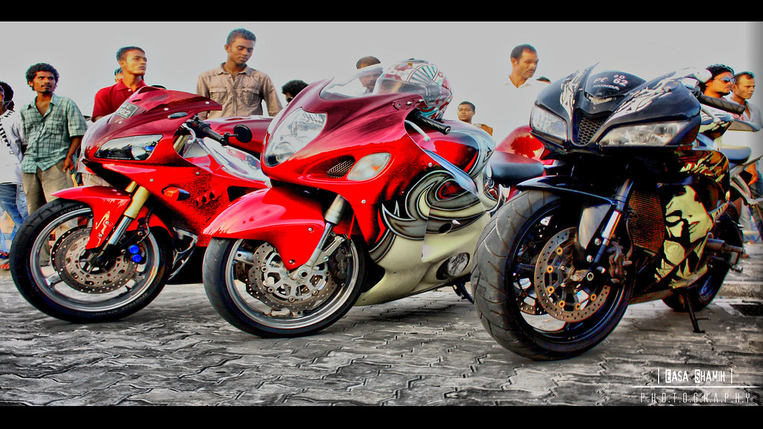
Problem: Finding the Best Bike
As per today’s market, Finding the best bike with particular specifications is hard for normal middle class people.
In this project, I’m going to find some best bikes with some specifications by my analysis.
Considering by some customer requirements & specifications.

Slide 3
STEPS INVOLVED IN ANALYSIS:
Web Scrapping
Data Collection
Data Cleaning
EDA
Visualization
Conclusion

Slide 4
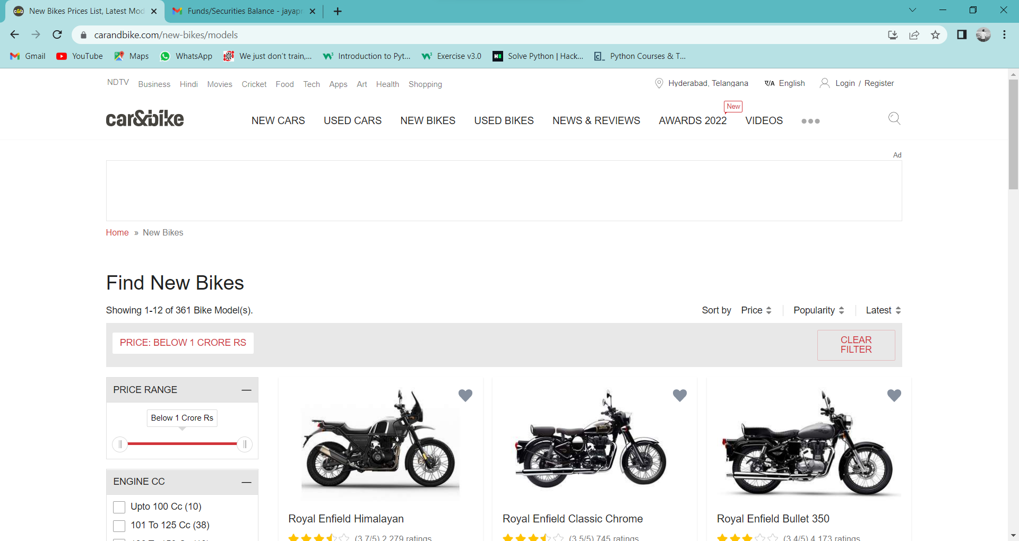
Web Scrapping:
Scrapped the data of new bikes from the website: carandbike.com.
After scrapping the whole new bikes data from the web, created a dataframe for that data.

Slide 5
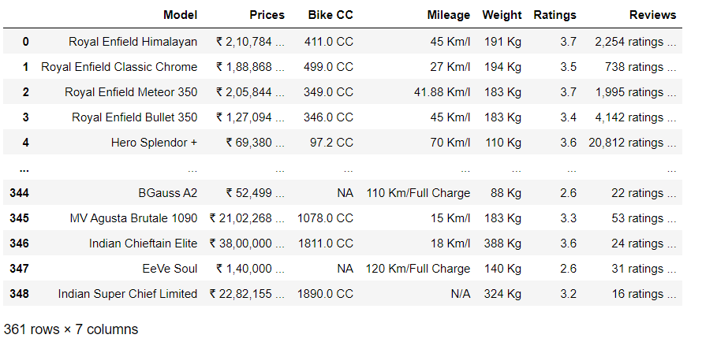
Data after web scrapping:

Slide 6
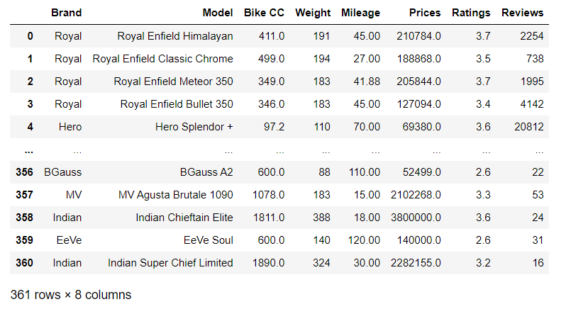
Data Cleaning:
Created a new column “Brand” using the existing “Model” column.
Removed the unwanted symbols & braces in data of each column.
Converted the Dtype of columns to required Dtype.
And rearranged the index of columns as per analysis requirement.
Filled the NaN values.

Slide 7
Comparison of Data
Before Cleaning
After Cleaning

Slide 8
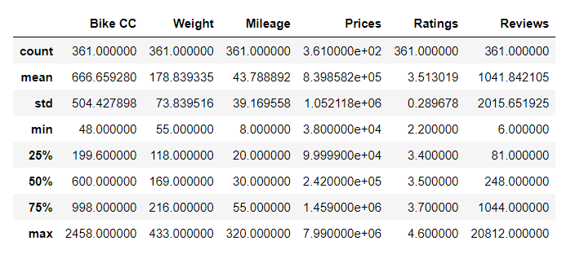
Statistics of the Data

Slide 9
Data Analysis
Univariant Analysis
Bivariant Analysis
Multivariant Analysis

Slide 10
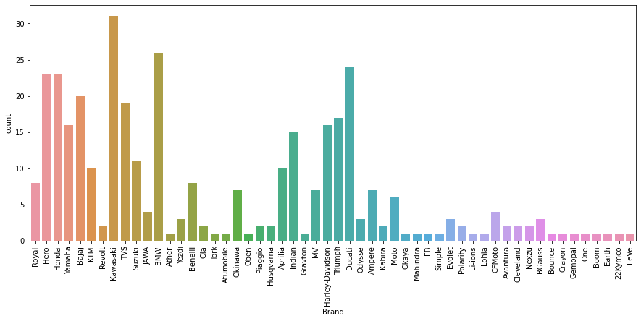
Univariant Analysis 1.Insights of Brand:
This graph represents the count of the models in each brand.
This graph shows us Kawasaki brand has the huge number of model bikes.

Slide 11
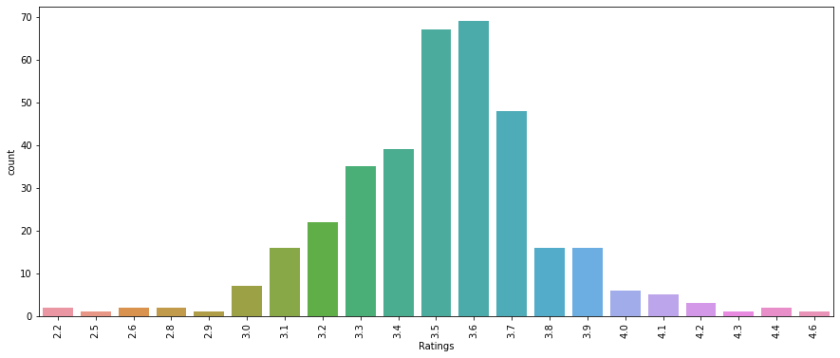
2.Insights of Ratings:
This graph represents the count of ratings of whole data.
This graph shows us the most of the bikes has the rating of 3.6

Slide 12
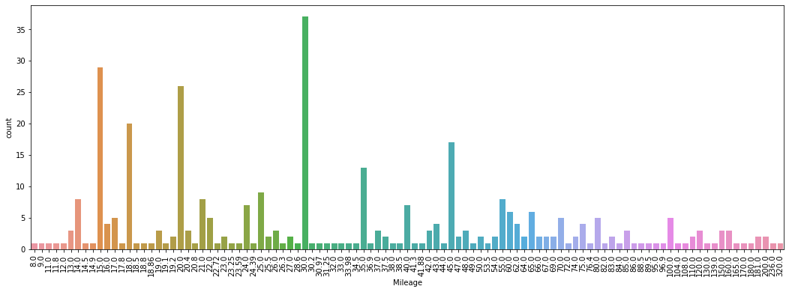
3.Insights of Mileage:
This graph represents the count of bikes of all mileages.
This graph shows us the most number of the bikes has the mileage of 30.0km/l.

Slide 13
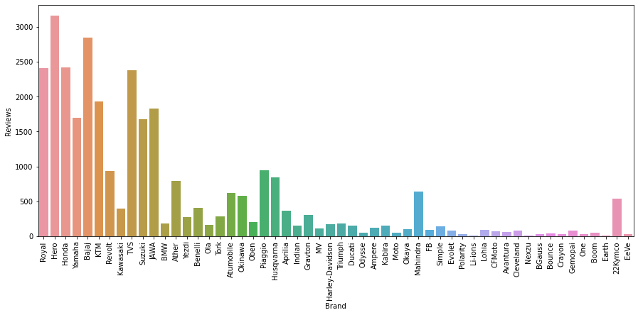
Bivariant Analysis 1.Analysis on most reviewed Brand:
This graph shows us the most reviewed brand is Hero.

Slide 14
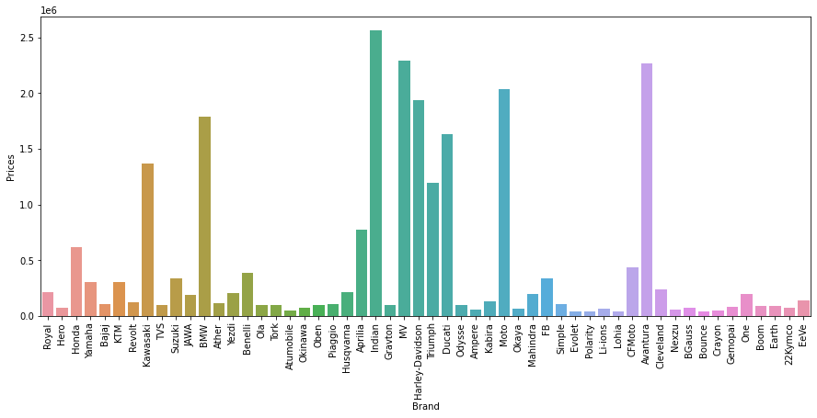
2.Analysis on most costliest Brand:
This graph shows us the most costliest brand is Indian.

Slide 15
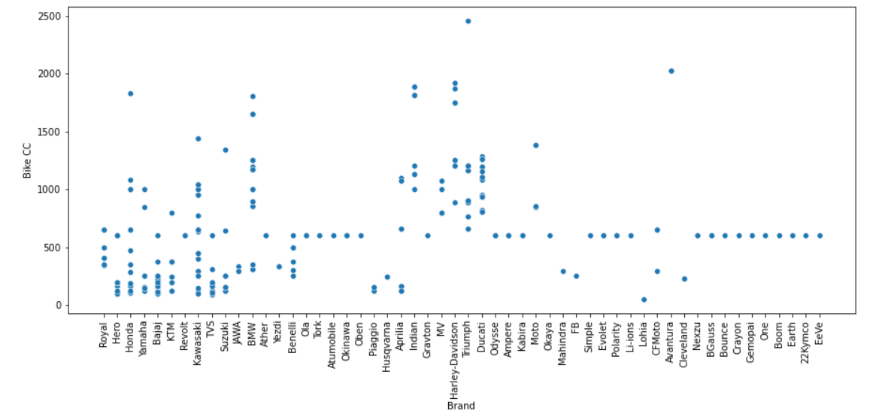
3.Analysis on Highest CC bike Brand:
This graph shows us the highest cc bike is the Triumph Brand.

Slide 16
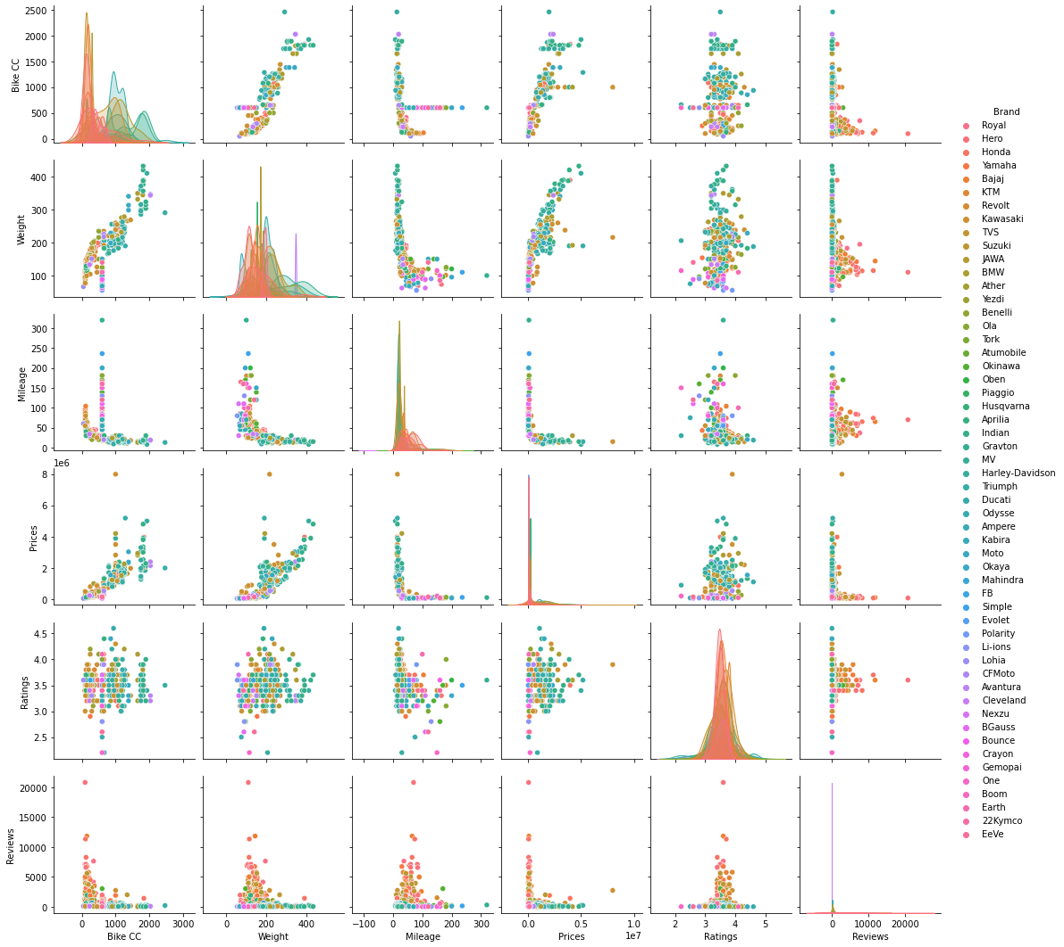
Multivariant Analysis
This graph shows us the co-relation between the each column.

Slide 17
Example: Some Customers requirements
Customer-1: Best bike in above 600cc & with minimum 2000reviews.
Customer-2: Best bike in 200to500cc with above 30mileage in the price range of below 2lakhs with 3.5above rating & minimum 3000reviews.
Customer-3: Best bike in below 150cc & above 60mileage with minimum 5000reviews.
Customer-4: Best bike in the price range of 1.5to3lakhs with 3.5above rating & minimum 5000reviews.

Slide 18
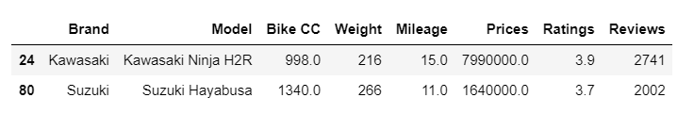
Customer-1:
As per the customer requirements.
This data shows us the bikes in above 600cc & with minimum 2000reviews.
By considering the mileage & rating.
The Best bike is Kawasaki Ninja H2R.

Slide 19
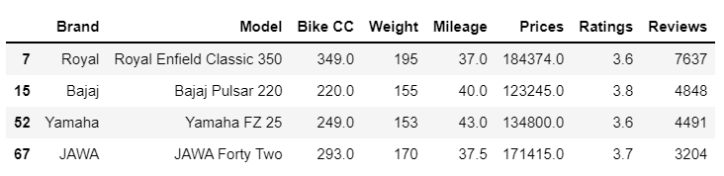
Customer-2:
As per the customer requirements.
This data shows us the bikes in 200to500cc with above 30mileage in the price range of below 2lakhs with 3.5above rating & minimum 3000reviews.
According to rating the best bike is
Bajaj Pulsar 220.

Slide 20
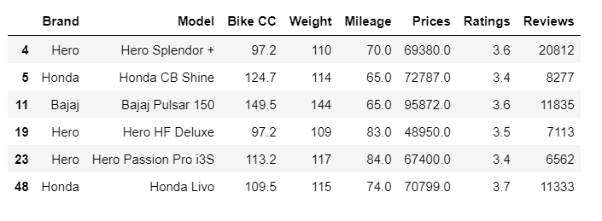
Customer-3:
As per the customer requirements.
This data shows us the bikes in below 150cc & above 60mileage with minimum 5000reviews.
According to mileage the best bike is Hero Passion Pro i3S.

Slide 21
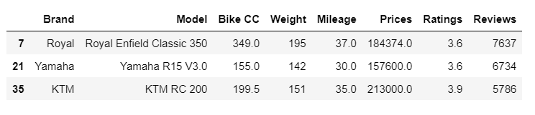
Customer-4:
As per the customer requirements.
This data shows us the bikes in the price range of 1.5to3lakhs with 3.5above rating & minimum 5000reviews.
According to rating KTM RC 200 is best & also according to CC Royal Enfield Classic 350 is best.

Slide 22
Conclusion:
It depends on the requirement of customers.
Considering the Overall data of Brands :
Highest reviewed Brand is Hero.
Costliest Bike is in Kawasaki Brand with Rs.79,90,000.0/-
Highest CC Brand is Kawasaki with 2458.0cc
Highly Rated Brand is Ducati with 4.6Rating

Slide 23

Any Doubts??

